Slide 1
SESSION 3

Slide 2
Postfix Expression Evaluation

Slide 3
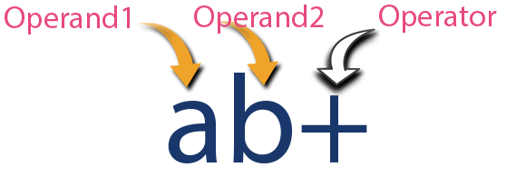
Postfix Expression
A postfix expression is a collection of operators and operands in which the operator is placed after the operands.
Image Reference : http://www.btechsmartclass.com/data_structures/expressions.html

Slide 4
Postfix Expression Evaluation using Stack

Slide 5
Algorithm
Read all the symbols one by one from left to right in the given Postfix Expression
If the reading symbol is operand, then push it on to the Stack.
If the reading symbol is operator (+ , - , * , / etc.,), then perform TWO pop operations and store the two popped operands in two different variables (operand1 and operand2). Then perform reading symbol operation using operand1 and operand2 and push result back on to the Stack.
Finally! perform a pop operation and display the popped value as final result.

Slide 6
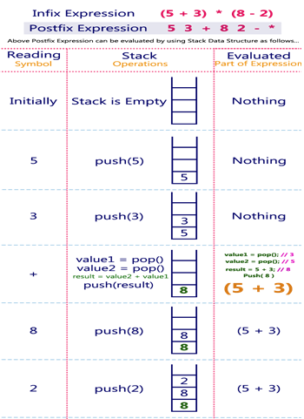
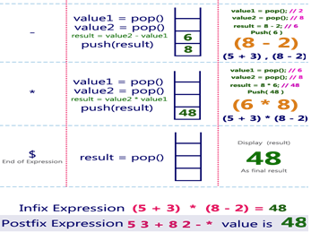
Example 1

Slide 7
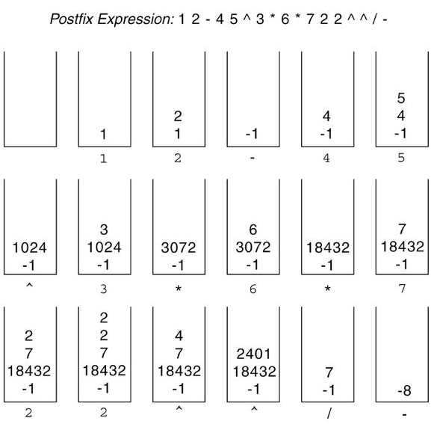
Example 2
Image from Data Structures by Mark Allen Weiss book

Slide 8
Balancing Symbols

Slide 9
Introduction
Stacks can be used to check if the given expression has balanced symbols or not.
The algorithm is very much useful in compilers.
Each time parser reads one character at a time.
If the character is an opening delimiter like ‘(‘ , ‘{‘ or ‘[‘ then it is PUSHED in to the stack.
When a closing delimiter is encountered like ‘)’ , ‘}’ or ‘]’ is encountered, the stack is popped.
The opening and closing delimiter are then compared.
If they match, the parsing of the string continues.
If they do not match, the parser indicates that there is an error on the line.

Slide 10
Balancing Symbols - Algorithm
Create a stack
while ( end of input is not reached ) {
If the character read is not a symbol to be balanced, ignore it.
If the character is an opening delimiter like ( , { or [ , PUSH it into the stack.
If it is a closing symbol like ) , } , ] , then if the stack is empty report an error, otherwise POP the stack.
If the symbol POP-ed is not the corresponding delimiter, report an error.
At the end of the input, if the stack is not empty report an error.

Slide 11
Example 1
Expression | Valid? | Description
(A+B) + (C-D) | Yes | The expression is having balanced symbol
((A+B) + (C-D) | No | One closing brace is missing.
((A+B) + [C-D]) | Yes | Opening and closing braces correspond
((A+B) + [C-D]] | No | The last brace does not correspond with the first opening brace.

Slide 12
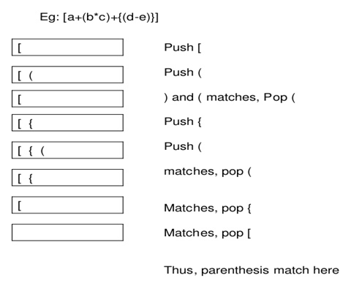
Example 2
Image Reference : https://github.com/niinpatel/Parenthesis-Matching-with-Reduce-Method

Slide 13
References
https://www.tutorialspoint.com/data_structures_algorithms/stack_algorithm.htm
https://www.codesdope.com/course/data-structures-stacks/
http://www.firmcodes.com/write-a-c-program-to-implement-a-stack-using-an-array-and-linked-list/
http://www.btechsmartclass.com/data_structures/stack-using-linked-list.html
http://www.exploredatabase.com/2018/01/stack-abstract-data-type-data-structure.html
https://www.geeksforgeeks.org/stack-set-2-infix-to-postfix/
https://www.hackerearth.com/practice/notes/stacks-and-queues/
https://github.com/niinpatel/Parenthesis-Matching-with-Reduce-Method
https://www.studytonight.com/data-structures/stack-data-structure
https://www.programming9.com/programs/c-programs/230-c-program-to-convert-infix-to-postfix-expression-using-stack

